Slide 1
Data Processing System
10/2/2020 Update

Slide 2
Overview
DPLIB
KPI Processing library
DPS Manager
Backend for React UI and Batch Processor

Slide 3
DPLIB
Backend logic for computing KPIs
Supports processing rows of data and aggregations
Many results or single result
Stand-alone Python package
Integrated into system (in Batch Processor micro-service)

Slide 4
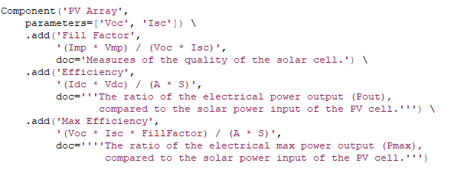
DPLIB - Component

Slide 5
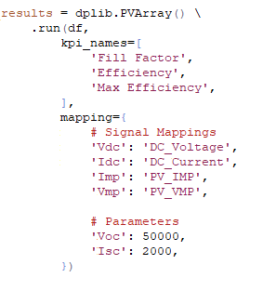
DPLIB – Running a Component

Slide 6
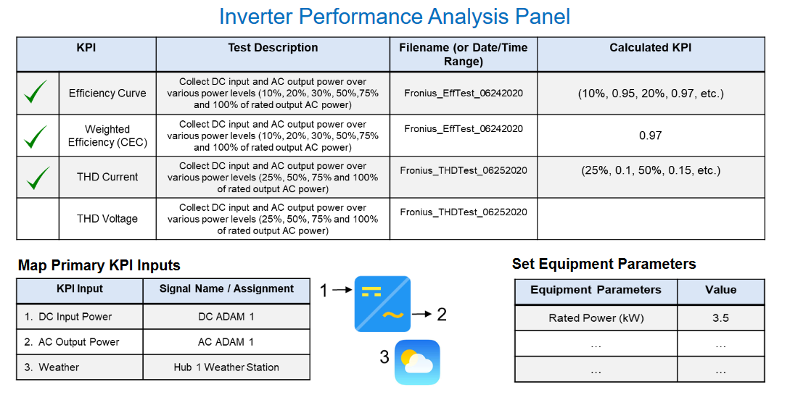
DPLIB – Relation to the UI

Slide 7
DPLIB – Producing many results
Time | Fill Factor | Efficiency | Max Efficiency
... | … | … | …
... | ... | ... | ...
... | ... | ... | ...
... | ... | ... | ...

Slide 8
DPLIB – Producing single results (aggregation)

Slide 9
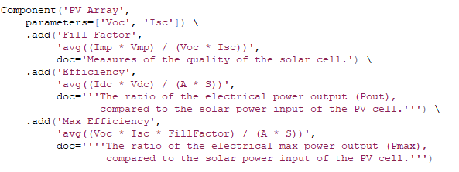
DPLIB – Producing one result (aggregation)
Component that specifies one result for each KPI
(i.e. a Python dictionary of results)
Component that specifies results per unit of time for each KPI
(i.e. a Pandas DataFrame of results)

Slide 10
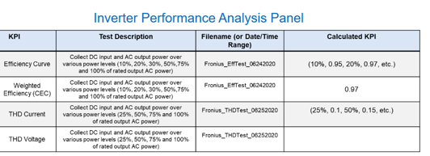
DPLIB – Producing one result (aggregation)
Fill Factor | Efficiency | Max Efficiency
… | … | …

Slide 11
DPLIB – Why produce single result?
Original design
Produce many results
Store KPIs to database
Run database “min”, “max”, “average” function to get final result
Display result on dashboard
New design
Produce single result
Display result on dashboard
Processed signals don’t need to be stored to the database
Don’t need to run aggregations (min, max, avg) on a database

Slide 12
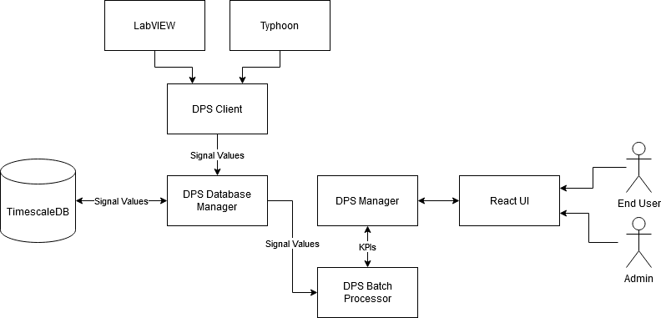
DPS Manager

Slide 13
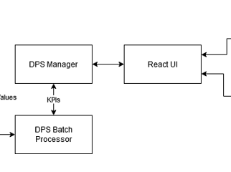
DPS Manager
Provides REST API for
DPS Batch Processor micro-service
React UI
Stores
Systems
Batch Processes
Batch Process Progress

Slide 14
DPS Manager – React UI API - Systems
Admin only object
Created within the React UI
Configures which dashboards are available for end-users
Parameterized version of Mike’s mock-up
Allows for creating dashboards without altering KPI code

Slide 15
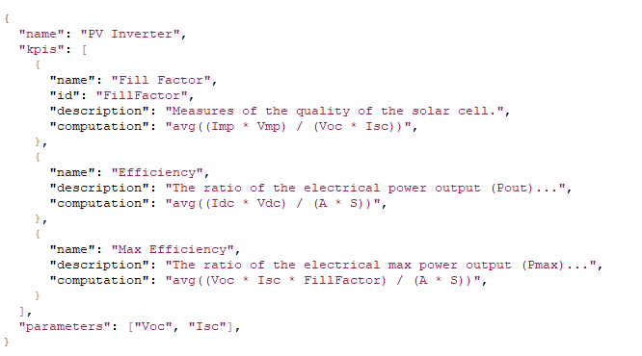
DPS Manager – React UI API - Systems

Slide 16
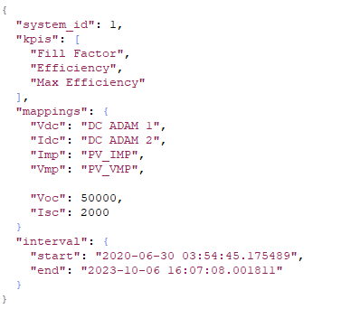
DPS Manager – React UI API – Batch Process

Slide 17
DPS Manager – DPS BP Server – Progress
While executing batch process, progress is reported to DPS Manager
Allows for batch processes to continue after failure/reboot
Allows for indicating on the UI how far a batch process is (in percent)

Slide 18
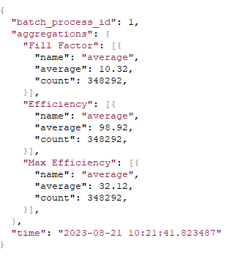
DPS Manager – DPS BP Server – Progress
The last aggregation value
Allows the computation to continue
after system failure.
The last time the batch process computed KPIs.
Allows for computing percent complete.

Slide 19
Questions

